Slide 1
Real-Time Vehicle Registration Data Analytics __________________________ Dataset Analysis & Visualization using PySpark
A.HEMANTH
2211cs010033
CSE(S1)

Slide 2
DATASET INFORMATION
Dataset Source: https://www.data.gov.in/resource/real-time-vehicle -registration-various-locations
**Dataset Metrics:**
Total Records: 1,000
Columns: 8 key attributes
Data Quality: Excellent
No missing values
No duplicate records
**Data Attributes:**
-Category, SubCategory, Year
-Value (Registration count)
-Region, FuelType, Transmission, OwnerType

Slide 3
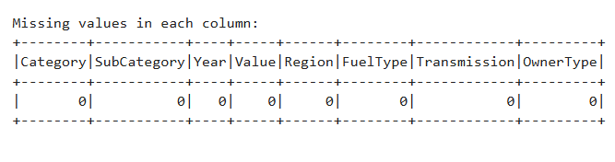
Initial Analysis
- Checked for missing and invalid values (e.g., 'NA')
- Replaced/removed nulls and converted columns to numeric types
- Dataset cleaned and ready for visualization

Slide 4
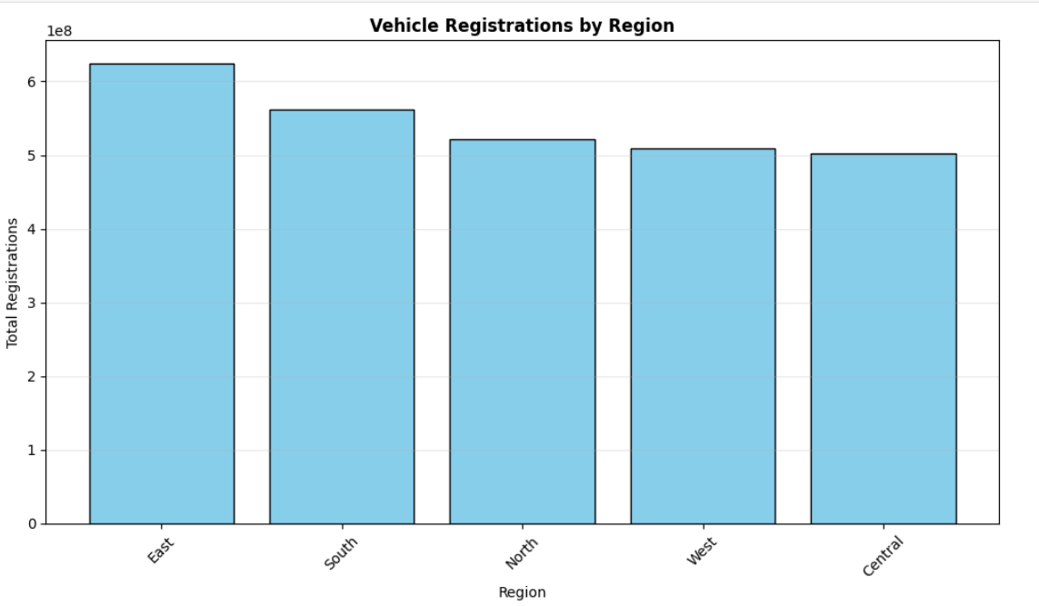
Registrations In Different Region
Here You can see the Vehicle Registration by different regions across the country.
The East region had the more vehicles compared to the other regions.
The central has the less compared to other.

Slide 5
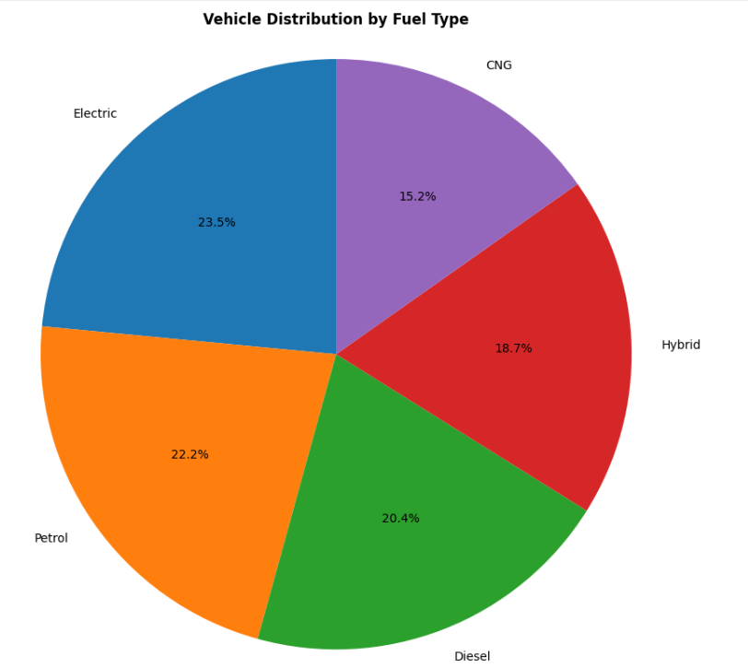
Distribution By Fuel
The most of the vehicles across many regions are Electric type.
The second mostly registered vehicles are petrol and followed is diesel.
The CNG are new model vehicles so it is less registered compared to other.

Slide 6
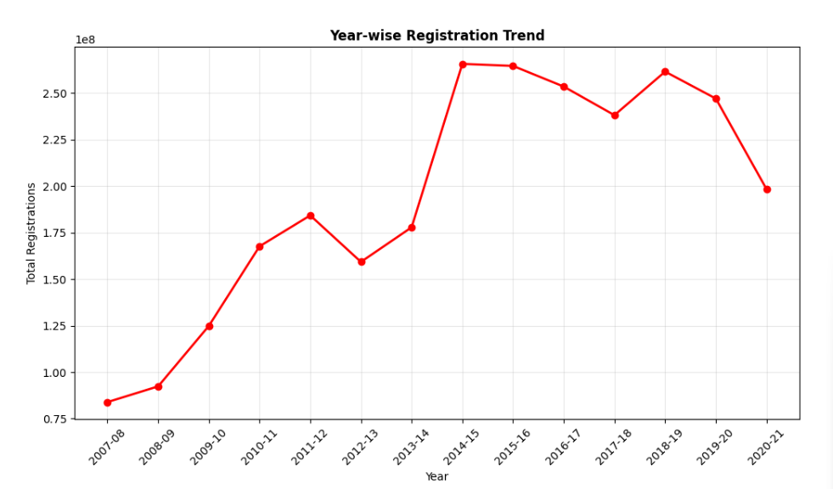
Registration Trend
The graph shows the year-wise registration of vehicles.
The highest registration of the vehicles aare in the year of 2014-2015.
After the year of 2014-2015 the registration has be decreased
The lowest is in the year of 2007-2008

Slide 7
Geographic Variations in Vehicle Choices
**Regional Insights:**
Different fuel preferences by region
Varied transmission choices
Regional economic indicators
Infrastructure impact on choices
**Policy Implications:**
Region-specific initiatives needed
Infrastructure planning requirements
Market development opportunities

Slide 8
Fuel Technology Adoption
**Current Status:**
- Electric: Early adoption phase
- Hybrid: Steady growth
- CNG: Established alternative
- Traditional fuels: Still dominant
**Future Outlook:**
- Accelerated EV adoption expected
- Hybrid as transition technology
- Sustainable mobility focus

Slide 9
Conclusion
Based on the vehicle registration analysis, India's automotive market shows robust growth with motorcycles dominating overall registrations. A clear technology transition is evident as electric and hybrid vehicles gain traction alongside traditional fuels. The market demonstrates balanced regional development with healthy private and commercial ownership patterns. These trends highlight an evolving automotive sector poised for continued transformation and expansion.

Slide 10


